Slide 1
Introduction
Intermediate code is the interface between front end and back end in a compiler
Ideally the details of source language are confined to the front end and the details of target machines to the back end (a m*n model)
In this chapter we study intermediate representations, static type checking and intermediate code generation
Parser
Static
Checker
Intermediate Code Generator
Code Generator
Front end
Back end

Slide 2
Intermediate Code
The Following are commonly used intermediate code representation:
Syntax tree
Postfix notation
Three-address code

Slide 3
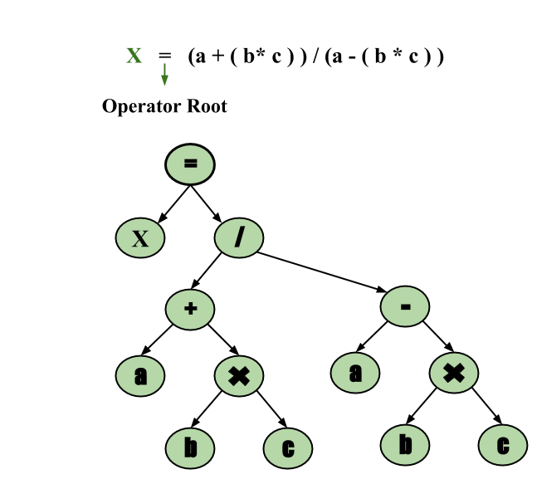
Syntax tree
Example: x = (a + b * c) / (a – b * c)

Slide 4
Postfix notation
Example:- The postfix representation of the expression
(a – b) * (c + d) + (a – b) is :
ab – cd + *ab -+

Slide 5
Three-Address Code
A statement involving no more than three references(two for operands and one for result) is known as a three address statement. A sequence of three address statements is known as a three address code. Three address statement is of form x = y op z, where x, y, and z will have address (memory location). Sometimes a statement might contain less than three references but it is still called a three address statement.
For Example: a=b+c*d;
The Intermediate code generator will try to devide this expression into subexpressions and then generate the corresponding code.
r1 = c*d;
r2 = b+r1;
a = r2

Slide 6
Variants of syntax trees Directed Acyclic Graphs for Expressions
It is sometimes beneficial to create a DAG instead of tree for Expressions.
This way we can easily show the common sub-expressions and then use that knowledge during code generation
Example: a+a*(b-c)+(b-c)*d
+
+
*
*
d
a
-
b
c

Slide 7
Three address code
In a three address code there is at most one operator at the right side of an instruction
Example:
+
t1 = b – c
t2 = a * t1
t3 = a + t2
t4 = t1 * d
t5 = t3 + t4
+
*
*
d
a
-
b
c

Slide 8
Data structures for three address codes
Quadruples
Has four fields: op, arg1, arg2 and result
Triples
Temporaries are not used and instead references to instructions are made
Indirect triples
In addition to triples we use a list of pointers to triples

Slide 9
Example
Three address code
t1 = minus c
t2 = b * t1
t3 = minus c
t4 = b * t3
t5 = t2 + t4
a = t5
b * minus c + b * minus c
Quadruples
Triples
Indirect Triples
op
arg1
arg2
result
op
arg1
arg2
op
op
arg1
arg2
minus
c
t1
0
minus
c
35
(0)
0
minus
c
*
b
t1
t2
1
*
b
(0)
36
(1)
1
*
b
(0)
minus
c
t3
2
minus
c
37
(2)
2
minus
c
*
b
t3
t4
3
*
b
(2)
38
(3)
3
*
b
(2)
+
t2
t4
t5
4
+
(1)
(3)
39
(4)
4
+
(1)
(3)
=
t5
a
5
=
a
(4)
40
(5)
5
=
a
(4)

Slide 10
Solve example :
-(a*b) + (c*d+e)

Slide 11
An Intermediate Instruction Set
Assignment:
x = y op z (op binary)
x = op y (op unary);
x = y
Jumps:
if ( x op y ) goto L (L a label);
goto L
Indexed assignments:
x = y[ z ]
y[ z ] = x
Procedure call/return:
param x, k (x is the kth param)
retval x
call p
enter p
leave p
return
retrieve x

Slide 12
If else statement example:
if(a<b) then t=1 else h=0
if(a<b) goto __
t=0
goto __
t=1

Slide 13
If else statement example: Backpatching: Backpatching is basically a process of fulfilling unspecified information. This information is of labels. It basically uses the appropriate semantic actions during the process of code generation.
If(a<b) then t=1 else t=0
If(a<b) goto 4
t=0
goto 5
t=1
..

Slide 14
If else statement example:
If((a<b) && (c<d)) then t=1 else t=0
if(a<b) goto __
t=0
goto __
if(c<d) goto__
goto__
t=1
..
if(a<b) goto (4)
t=0
goto (7)
if(c<d) goto (6)
goto (2)
t=1
..

Slide 15
Solve example: If(a<b && c<b) then x = a+b+c else x= a-b+c

Slide 16
For loop:
Example :
For (i=1;i<=n;i++)
{
X = a+b*c;
}
Three address code
i=1
If(i<=n) goto __
goto__
t1 = b*c
t2 = a+t1
X = t2
i = i+1
goto __
..

Slide 17
For loop:
example :
for (i=1;i<=n;i++)
{
x = a+b*c;
}
Three address code
i=1
if(i<=n) goto 4
goto 9
t1 = b*c
t2 = a+t1
x = t2
i = i+1
goto __
..

Slide 18
While loop :
Three address code
if (A < C) goto (3)
goto (15)
if (B > D) goto (5)
goto (15)
if (A = 1) goto (7)
goto (10)
T1 = c + 1
c = T1
goto (1)
if (A <= D) goto (12)
goto (1)
T2 = A + B
A = T2
goto (10)
while (A < C and B > D){
if A = 1 then C = C + 1
else
while (A <= D){
A = A + B
}
}

Slide 19
Do while loop :
c = 0
do{
if (a < b) then
x++;
else
x–;
c++;
} while (c < 5)
Three address code
c = 0
if (a < b) goto (4)
goto (7)
T1 = x + 1
x = T1
goto (9)
T2 = x – 1
x = T2
T3 = c + 1
c = T3
if (c < 5) goto (2)

Slide 20
Solve example:
a=0,b=1;
for (i =0;i<5;i++){
c=a+b;
a=b;
b=c;
}

Slide 21
Switch case:
Three address code
if(i==1) goto __
if(i==2) goto __
t1 = b3*c3
t2 = a3+t1
x3 = t2
t1 = b1*c1 (case1)
t2 = a1+t1
x3 = t2
goto __
t1 = b2*c2 (case 2)
t2 = a2+t1
x3 = t2
goto __
..
switch(i)
{
case 1:
x = a1+b1*c1;
break;
case 2:
x = a2+b2*c2;
break;
default:
x = a3+b3*c3;
break;
}

Slide 22
Switch case:
three address code
if(i==1) goto 6
if(i==2) goto 10
t1 = b3*c3
t2 = a3+t1
x3 = t2
t1 = b1*c1 (case1)
t2 = a1+t1
x3 = t2
goto 14
t1 = b2*c2 (case 2)
t2 = a2+t1
x3 = t2
goto 14
..
switch(i)
{
case 1:
x = a1+b1*c1;
break;
case 2:
x = a2+b2*c2;
break;
default:
x = a3+b3*c3;
break;
}

Slide 23
Function call:
X = foo(a, b);
Solve: p = bar(x, y, z);
Three address code:
param a
param b
call foo, 2, t1
x = t1

Slide 24
Array:
x= 0
i = 0
If(i>=10) goto 15
T1 = base add of A
T2 = i*2
T3 = t1[t2]
T4 = base add of A
T5 = i*2;
T6 = t4[t5]
T7 = t3*t6
T8 = x+t7
x= t8
i = i+1
Goto 3
..
Int a[10], B[10]
Int x =0,I;
For (i=1;i<10;i++)
{
x = x +a[i]*b[i];
}
Formula for fetch value from array
A[i] = BA + (i-lb) * c

